Slide 1
UCSF Land Acknowledgement
Slides adapted with permission from Tasce Bongiovanni, MD, MPP, MHS, Assistant Professor, Department of Surgery, Diné and Anne Montgomery, MD, Assistant Professor, Department of Medicine, Cherokee Nation of Oklahoma.

Slide 2
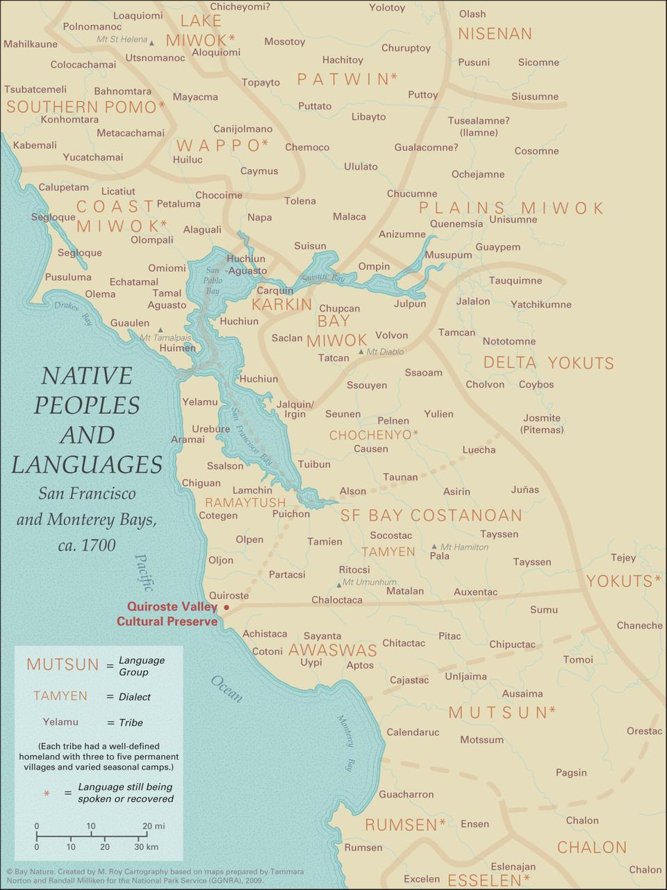
  Recognize the past and the present of Native American culture
  Counter the “doctrine of discovery” with the true story of the people who were already here
  Remind us that colonization happened and is happening
  Invite all of us to recognize the ways in which we benefit from settler-colonialism and inspire action
  Offer recognition and respect
  Create public awareness
Why land acknowledgements?

Slide 3
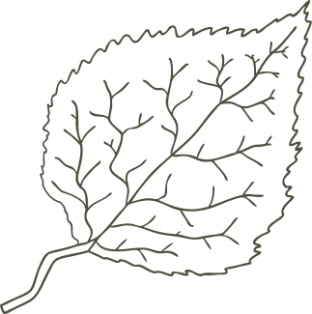
What is a land acknowledgement?
  A statement offered to open meetings, ceremonies, lectures, and public events.
  It recognizes Indigenous people and the importance of the land, plants, and animals.
  The most basic acknowledgment can be very simple, naming the Native peoples of the land being occupied by the event.
  Should be created in relationship with the local Indigenous people.
  The ultimate goal is rematriation – the giving back of land and resources to tribes and Indigenous communities.

Slide 4
We would like to acknowledge the Ramaytush Ohlone people, who are the traditional custodians of this land.
We pay our respects to the Ramaytush Ohlone elders, past, present, and future who call this place, the land that UCSF sits upon, their home. We are proud to continue their tradition of coming together and growing as a community.
We thank the Ramaytush Ohlone community for their stewardship and support, and we look forward to strengthening our ties as we continue our relationship of mutual respect and understanding.

